Slide 1

ABC Call Volume Trend Analysis trainity Project#8
By:
ANURAG CHANGMAI
Data Analytics Trainee

Slide 2
Project Description
Customer experience (CX) plays a crucial role in the operations of any business. By analyzing this CX, businesses can derive insights and understand the opinions of their customers. This, in turn, helps them plan out their future journey.
One of the key roles in the CX team is that of customer service representatives or call center agents. They are instrumental in providing support to customers through various media, like call, email, etc. Hence, improving their working significantly impacts CX for a business.
In this project, I perform the role of a data analyst for a company named ABC. In my role, I provide various insights that lead to efficient manpower planning. This is essential to improving ABC’s CX standards and turning leads into customers and profit.

Slide 3
Approach
This project begins by first obtaining a sample dataset of call center agents and their work. This dataset carries information for almost 1,18,000 calls, with parameters such as agent ID, queue time, call duration, call status, etc.
This data is then cleaned before being used, and outliers are noted to ensure all data points are taken into consideration. For better clarity, data is represented in a tabular form and a chart form wherever possible.

Slide 4
Tech-Stack Used
In the execution of this project, the following software was used:
1. Microsoft Excel 2019 v2307
→ It was used to understand the data, which was in XLSX format, clean it, filter it, obtain results from it, and display the same in tabular and chart forms.

Slide 5
Insights
Over the following slides, I will try to obtain insights on:
Average call duration
Call volume analysis
Day shift manpower planning
Night shift manpower planning

Slide 6
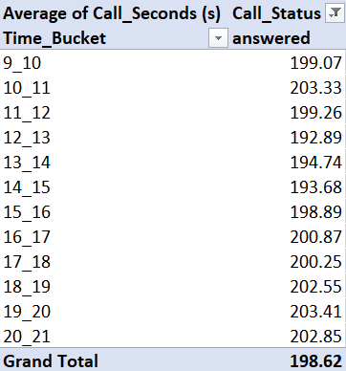
1. Average call duration
The pivot table on the right shows the average call duration in seconds for each time bucket. It was observed that bucket 19_20 i.e. from 7 pm to 8 pm saw the longest average call duration at 203.41 seconds.
This information has been shown in the next slide in the form of a column graph for better visual representation.

Slide 7
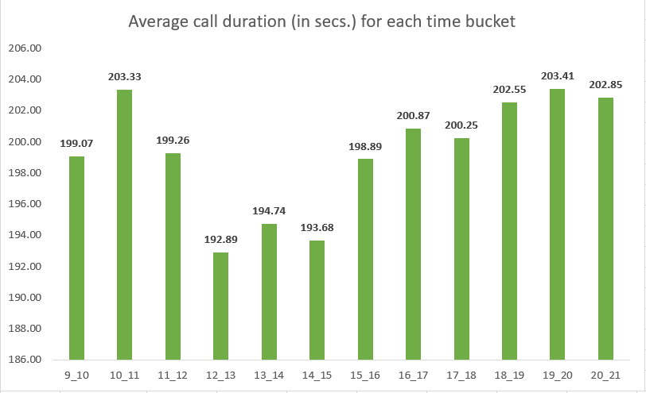
1. Average call duration (Cont.)

Slide 8
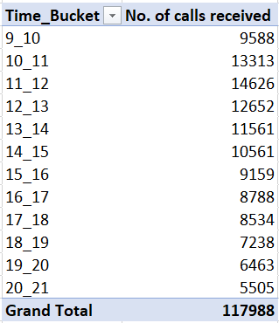
2. Call volume analysis
The pivot table on the right shows the total number of calls received in each time bucket. It was observed that bucket 11_12 i.e. from 11 am to 12 pm received the highest number of calls at 14626 calls.
This information has been shown in the next slide in the form of a column graph for better visual representation.

Slide 9
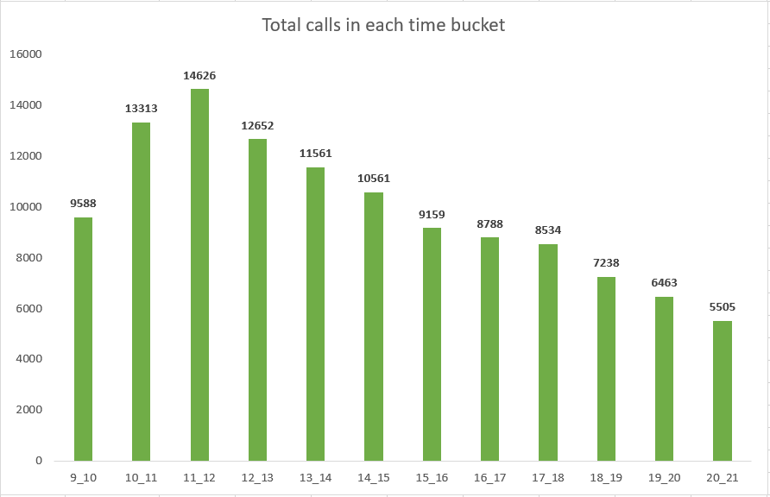
2. Call volume analysis (Cont.)

Slide 10
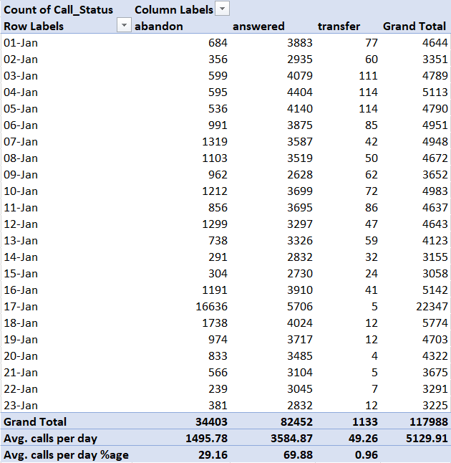
3. Day shift manpower planning
The table on the right shows call data from January 01 to January 23 of the year in consideration.
It is seen that the rate of abandoning, answering, and transferring calls is 29.16%, 69.88%, and 0.96% respectively.
For ease of calculations, the abandoning and answering rates are considered as 30% and 70% respectively. Transfer rates are ignored as they are minuscule.
It is also seen that the average number of calls per day is 5130.

Slide 11
3. Day shift manpower planning (Cont.)
The requirements state that the current abandoning rate of 30% has to be reduced by 20% to a final abandoning rate of 10%. This means that the answering rate has to be introduced by 20% from the current 70% to a final 90%.
Previous analysis shows that the average duration for all answered calls stands at 198.6 seconds.
Now, average calls per day = 5130
seconds per hour = 3600

Slide 12
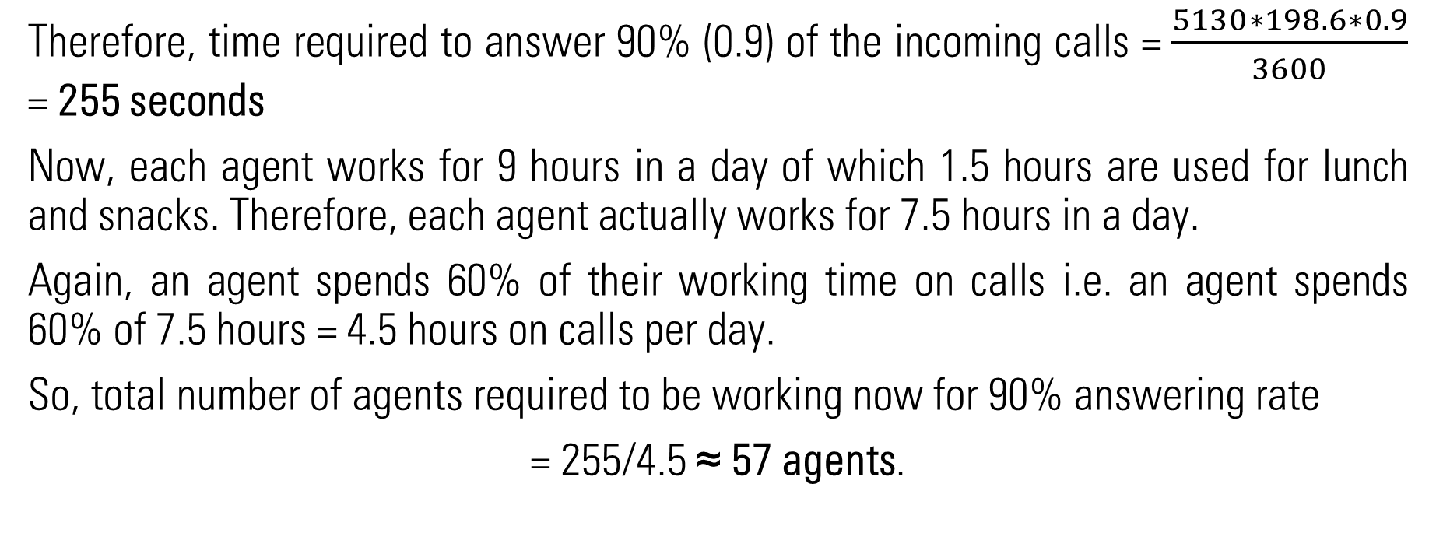
3. Day shift manpower planning (Cont.)
Therefore, time required to answer 90% (0.9) of the incoming calls = $\frac{5130∗198.6∗0.9}{3600}$ = 255 seconds
Now, each agent works for 9 hours in a day of which 1.5 hours are used for lunch and snacks. Therefore, each agent actually works for 7.5 hours in a day.
Again, an agent spends 60% of their working time on calls i.e. an agent spends 60% of 7.5 hours = 4.5 hours on calls per day.
So, total number of agents required to be working now for 90% answering rate
= 255/4.5 ≈ 57 agents.

Slide 13
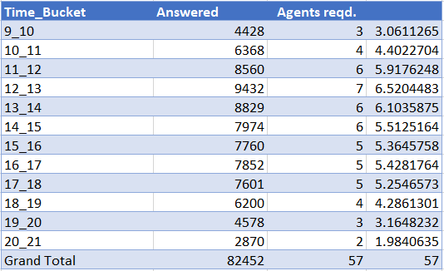
3. Day shift manpower planning (Cont.)
The distribution of these 57 agents across the time buckets is shown below. The same information is represented in a graphical format using a column graph in the next slide.

Slide 14
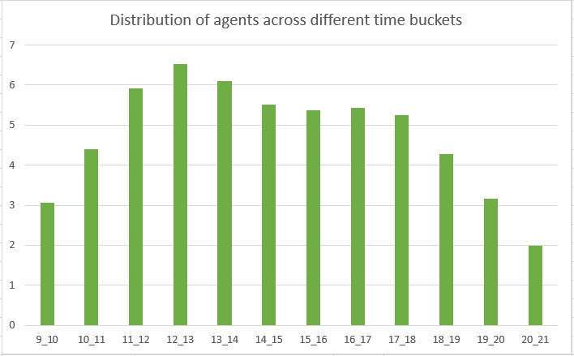
3. Day shift manpower planning (Cont.)

Slide 15
4. Night shift manpower planning
The following information was provided for call volume and distribution during the night shift from 9 pm to 9 am:
For every 100 calls received between 9 am to 9 pm, 30 calls were received between 9 pm to 9 am.
The call distribution across different time buckets are:

Slide 16
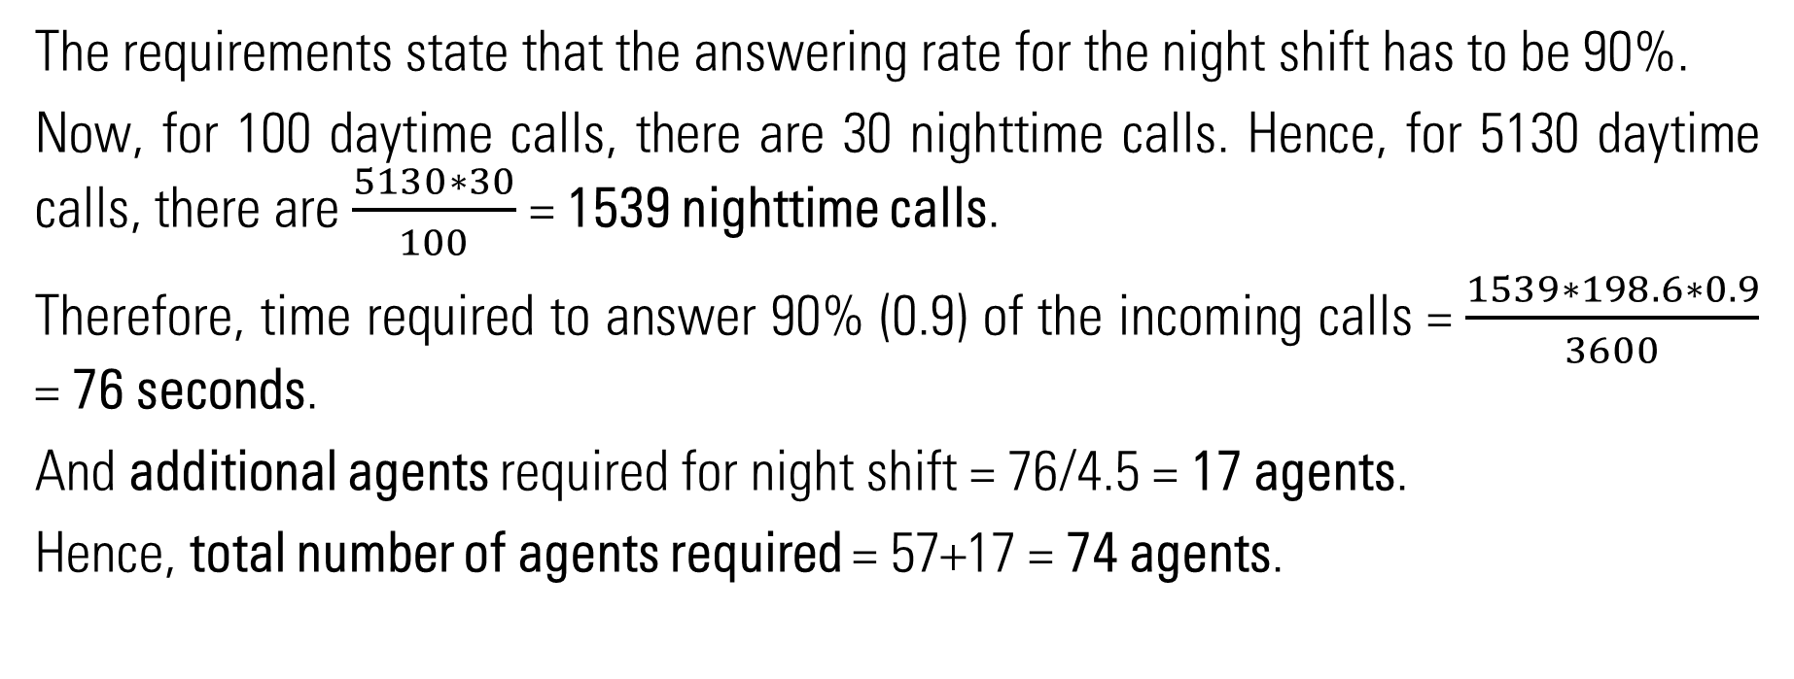
4. Night shift manpower planning (Cont.)
The requirements state that the answering rate for the night shift has to be 90%.
Now, for 100 daytime calls, there are 30 nighttime calls. Hence, for 5130 daytime calls, there are $\frac{5130∗30}{100}$ = 1539 nighttime calls.
Therefore, time required to answer 90% (0.9) of the incoming calls = $\frac{1539∗198.6∗0.9}{3600}$ = 76 seconds.
And additional agents required for night shift = 76/4.5 = 17 agents.
Hence, total number of agents required = 57+17 = 74 agents.

Slide 17
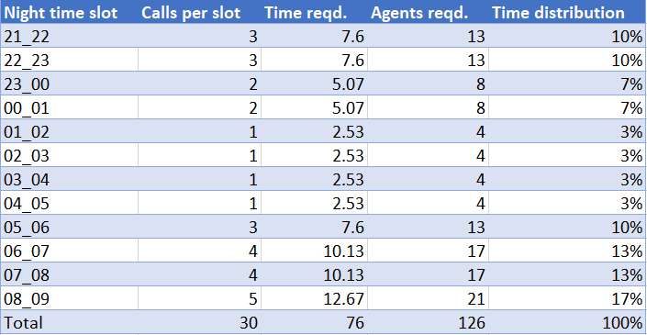
4. Night shift manpower planning (Cont.)
The distribution of these 17 agents across the time buckets is shown below. The same information is represented in a graphical format using a column graph in the next slide.

Slide 18
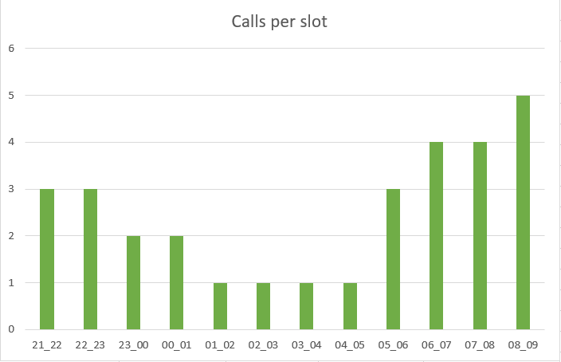
4. Night shift manpower planning (Cont.)

Slide 19
4. Night shift manpower planning (Cont.)
The previous table shows the distribution of the nighttime calls to ensure a 90% answering rate. However, since there are only 17 agents during the night shift, they must be distributed in such a way that their time buckets overlap to ensure continuous call coverage.
Hence, it is suggested that the agents who work in the 19_20 and 20_21 time buckets should continue working into the 21_22 and 22_23 time buckets as well.
Similarly, agents who work during the 9_10 and 10_11 time buckets can be asked to work during the 7_8 and 8_9 time buckets as well.
Finally, the agents who work in the time buckets 1_2, 2_3, 3_4, and 4_5 can be asked to work in the time buckets 6_7, 7_8, and 8_9 as well.
Together, these steps should ensure an answering rate of 90%.

Slide 20
Result
Based on the insights obtained from the dataset, it can be seen that:
The longest average call duration is 203.41 seconds, observed between 7 pm and 8 pm.
The highest number of calls are received between 11 am to 12 pm (14626 calls), which means this timeframe should be highly and efficiently manned.
A total of 74 agents (57 daytime and 17 nighttime) are required to ensure a 90% answering rate for all calls.

Slide 21
Result (Cont.)
This project has been crucial in helping me understand how business planning is greatly impacted by customer experience. In turn, I could understand how customer experience is dependent on proper support call handling. Hence, businesses should focus more on the training and development of customer service representatives if they are to provide efficient support to the customer, retain the loyalties of existing customers, and attract new customers.
The full dataset can be found here.

